Slide 1

Operating Systems Lab

Slide 2
Monitors
Lab Instructor: Saba Naseem
(FAST-NU CFD Campus).
Email: saba.naseem@nu.edu.pk

Slide 3
Monitors
A class providing both synchronization and notification.
The Monitor class is based on the concept of a Mutex and a Conditional Variable.
Mutex is used to synchronize access to a shared object.
Condition Variable is used to wake up waiting threads when the shared object has changed.
Monitor can also be considered as a class whose data members are private and whose member functions are implicitly executed with mutual exclusion.
Monitors can be included in a language (Mesa, Java) but in C++, they are just a programming pattern that involves a structured way of using mutex and condition variables.

Slide 4
Rules to Follow with Monitors
Any process can call a monitor procedure at any time
But only one process can be inside a monitor at any time (mutual exclusion)
No process can directly access a monitor‟s local variables (data encapsulation)
A monitor may only access its local variables why? Race conditions could occur!

Slide 5
Monitors in C++
POSIX Threads
No compiler support, must do it manually
Must declare locks & condition vars
Must call lock_acquire/lock_release when entering&leaving the monitor
Must use cond_wait/cond_signal to wait for/signal condition
Note: cond_wait(&c, &m) takes monitor lock as parameter
Necessary so monitor can be left & re-entered without losing signals

Slide 6
Example (Monitors)
Problem Statement:
Class BankAccount
  Use monitor as a bank account i.e. Threads withdraws and deposit money
deposit()
  Deposit money as long as the balance<500.
  If balance >=500 signal the withdraw function that is waiting.
Withdraw()
  Waiting for a signal from the deposit() (balance >=500), withdraw the amount and signal back
  If amount to be withdrawn is greater than balance quit the program

Slide 7
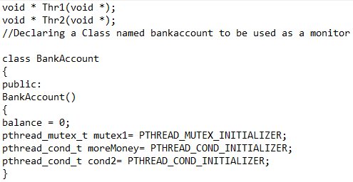
Example (Monitors)
(Class and Constructor)

Slide 8
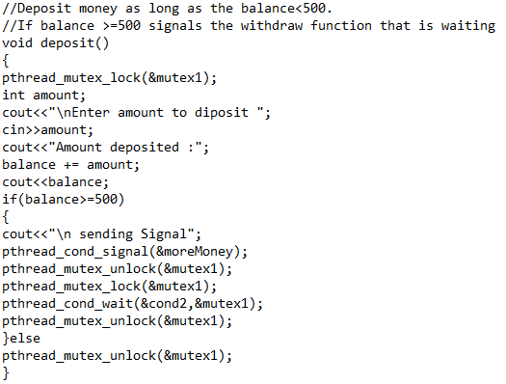
Example (Monitors)
(deposit)

Slide 9
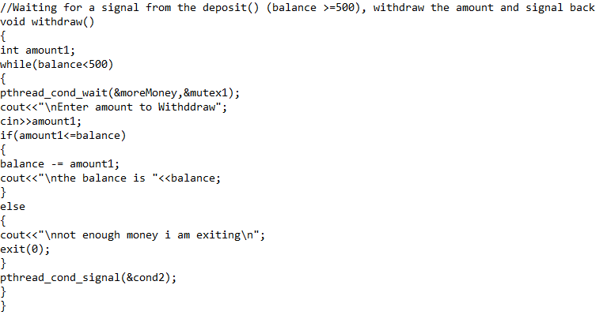
Example (Monitors)
(withdraw)

Slide 10
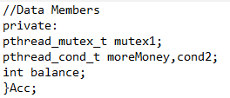
Example (Monitors)
(Data Members of BankAccount)

Slide 11
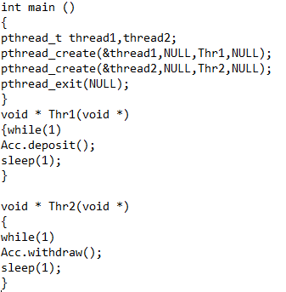
Example (Monitors)
(main() and thread functions)

Slide 12
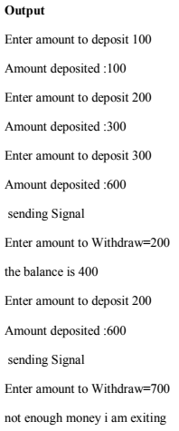
Example (Monitors)
(Output)

